Slide 1
How to Request Public Lands Corps Certificates
PLC Implementation Guide for Forest Service Partners (click here)
PLC Resource Guide for Participants (click here)
U.S. Forest Service, National Partnership Office
Workforce Development Partnerships Hub
November 3, 2023

Slide 2
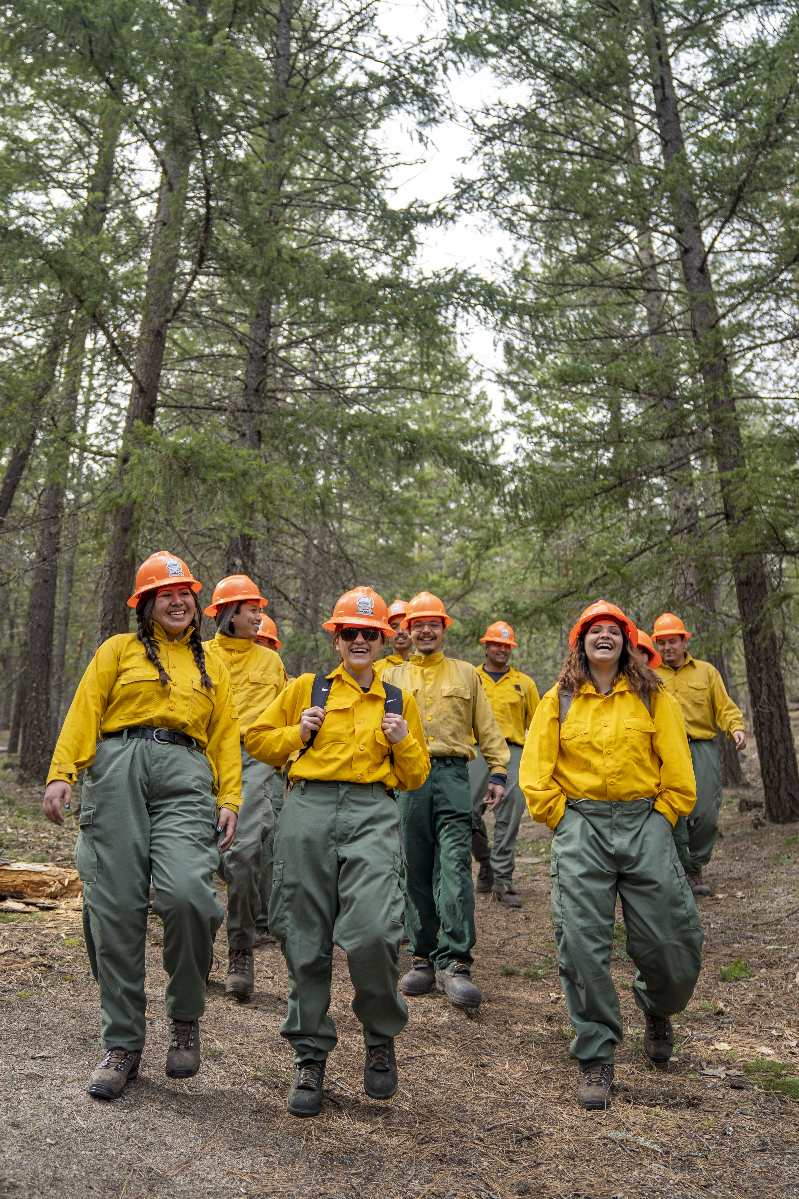
What is Public Lands Corps?
Work/education program: Young adults contribute to the conservation, restoration, and rehabilitation of public lands while gaining paid work experience and job training in a variety of resource management fields.
Partnership-based: Accomplished through partnerships with corps, non-profits, colleges and universities. Indian Youth Service Corps, established in 2019, engages Indigenous young adults through Tribal partnerships.
Creates career pathways: PLC and IYSC participants earn a 2-year PLC hiring authority (PLC certificate).

Slide 3
FS Public Lands Corps: 2023 Stats
220 PLC certificates issued
21 partner organizations
Regions | # Certs Issued
Job Corps | 80
Southern (Region 8) | 50
Rocky Mountain (Region 2) | 28
Pacific Northwest (Region 6) | 19
Eastern (Region 9) | 16
Southwestern (Region 3) | 9
Alaska (Region 10) | 8
Intermountain (Region 4) | 6
Pacific Southwest (Region 5) | 2
Partners | # Certs Issued
Student Conservation Association | 43
Chicago Botanic Garden | 14
Conservation Legacy | 14
Mt. Adams Institute | 11
Rocky Mountain Youth Corps (CO) | 10
Colorado Mesa University | 8
Appalachian Forest Heritage Area | 6
Geological Society of America | 5
Southern Appalachian Wilderness Stewards | 5
Walking Mountains Science Center | 5
Notes:
Estimate 2,500 FS PLC participants in 2023 based on prior year’s VSReports data. Big gap between PLC program participation and PLC certificate issuance. Only 10% of participants are being issued PLC certificates.

Slide 4
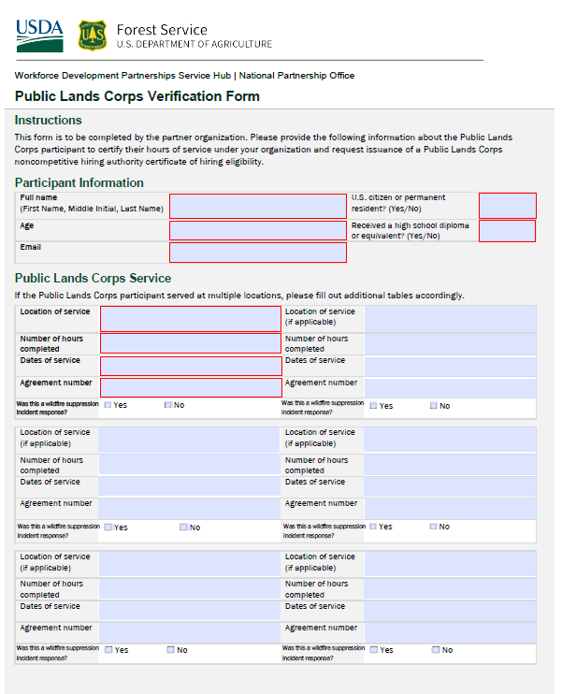
How do I request a PLC certificate?
Complete a PLC Verification Form for each eligible participant.
Verify that the participant has met all of the PLC requirements before signing the form.
Age: Participants must be aged 16-30 (inclusive) and veterans up to age 35
Citizenship: Participants must be U.S. citizens, nationals, or permanent residents.
Education: Participants have received their high school diploma or equivalent.
Hours: Participants have completed 640 hours under an eligible agreement, with at least 120 hours on National Forest System lands or Indian lands
Notes:
PLC certificate = documentation of eligibility for the PLC hiring authority

Slide 5
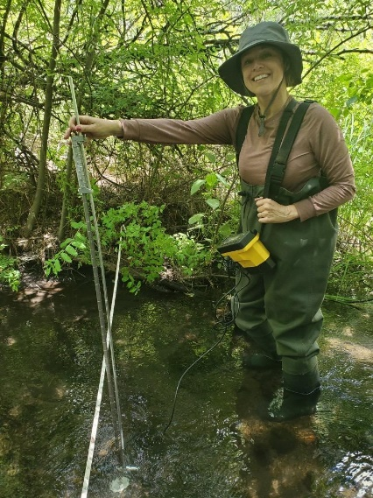
Can a participant work across multiple land jurisdictions (FS, NPS, BLM) under our organization to reach 640 hours?
Yes! 640 hours must be completed on eligible service lands* and of those, at least 120 hours on National Forest System lands or Indian lands
*public lands (inclusive of federal lands managed by other federal agencies, as well as state, county, local and municipal lands), Indian lands, and Hawaiian homelands.
All PLC requirements must be met on the non-FS agreements.

Slide 6
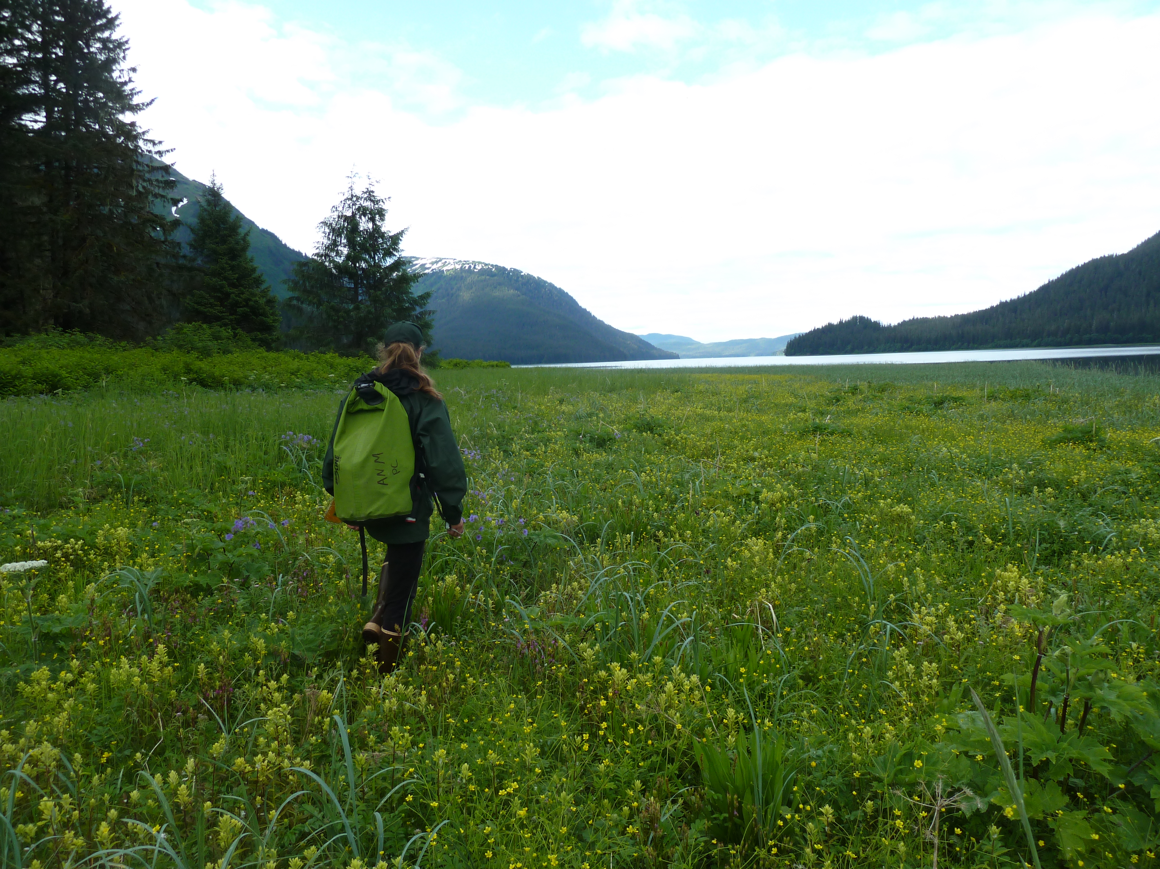
Can a participant combine hours across multiple organizations to reach 640 hours?
Yes! Please complete a separate PLC verification form for each organization and submit them to the Forest Service (or the agency where they completed the most hours).

Slide 7
A participant completed their PLC term a while back but we never requested their PLC certificate. Can we request a certificate now?
Yes! You must be able to verify the participant met the PLC eligibility criteria and minimum hours via the PLC Verification Form.
Participant must still be under the age of 30 (or 35 if a veteran).

Slide 8
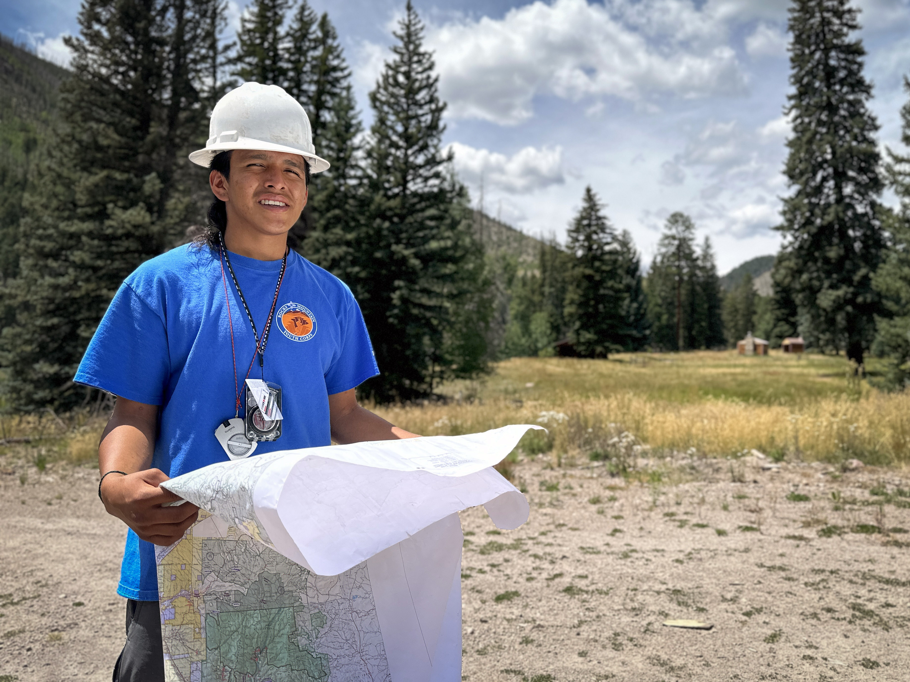
How do I request a PLC certificate?
Submit the PLC Verification Form to your Forest Service point-of-contact. If you are unsure of who that is, you may reach out to the lead point-of-contact in your geographic region.
Forest Service will confirm all requirements have been met and issue the participant a signed PLC certificate.

Slide 9
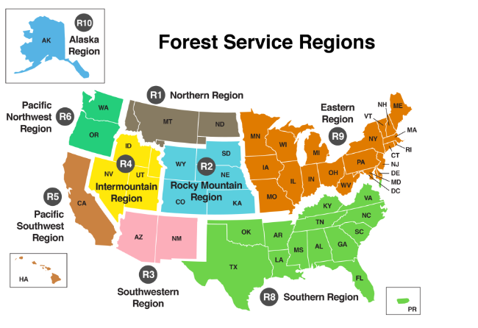
Lead PLC contacts by region
Region 1: Jeff Miller, jeffrey.m.miller@usda.gov
Region 2: Chandra Allred, chandra.allred@usda.gov
Region 3: Daisy Morgan, kristina.morgan@usda.gov
Region 4: Bill Lyons, william.lyons@usda.gov
Region 5: Kathy Mick, kathleen.mick@usda.gov; Taylor Livingston, taylor.livingston@usda.gov
Region 6: Rachel LaMedica, rachel.lamedica@usda.gov
Region 8: Krista Langley, krista.langley@usda.gov; Meredith Casper, meredith.casper@usda.gov; Juliana Defriese, juliana.defriese@usda.gov
Region 9: Joshua Keenan, joshua.keenan@usda.gov
Region 10: Don MacDougall, donald.macdougall@usda.gov

Slide 10
Getting your PLCs hired!
PLCs must be onboarded within 2 years of when their PLC certificate was signed and before their 33rd birthday (or 38th birthday, if a veteran).
Notes:
Because the federal application and selection process can take several months, it is highly recommended that you begin searching and applying for positions well before your certificate is set to expire.

Slide 11
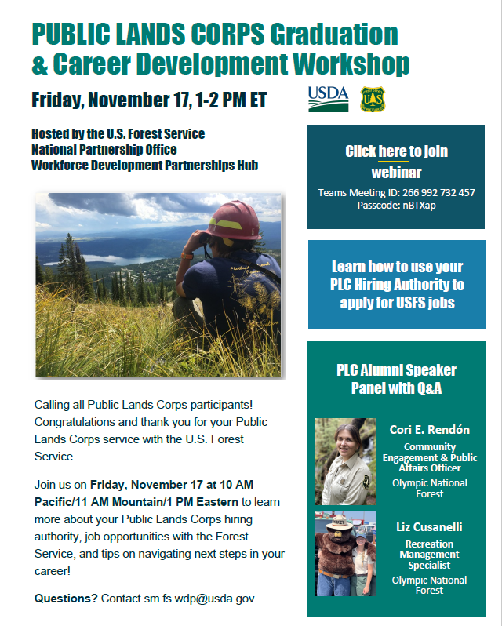
Getting your PLCs hired!
PLC Graduation & Career Development Workshop on Friday, Nov 17 from 1-2 PM ET
FS hiring up to 2,300 permanent seasonal forestry technicians and aids nationwide. Apply now through Wed, Nov 22.

Slide 12
Questions?
Contact: sm.fs.wdp@usda.gov

